Slide 1
Interactive Slides From OETC
Full PowerPoint Available
Author Amy Roediger, Mentor Schools

Slide 2
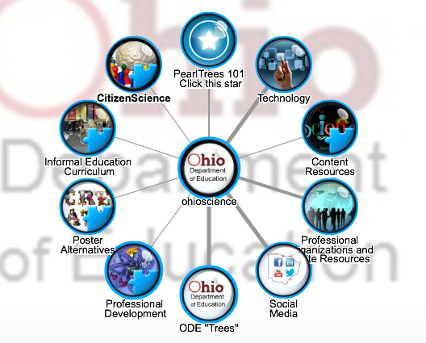
How Can Technology Help With Alignment to Standards?
Try some of these resources!

Slide 3
How Can Technology Help With Science Focus?
Try some of these resources!

Slide 4
How Can Technology Help With Instructional Supports?
Try some of these resources!

Slide 5
How Can Technology Help With Assessment?
Try some of these resources!

Slide 6
My Contact Info:
Amy Roediger
roediger@mentorschools.org
Mentor High School
6477 Center St
Mentor, OH 44060

